Slide 1
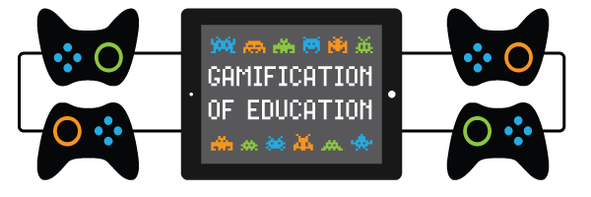
Hackathon
TEAM PURPLE

Slide 2
1. Product Brand
Gamification Design Professional (GamePro)
Purpose: Professionalize and establish standards of measurement for gamification in online learning
Tag line: Where creativity and measurement meet
Brand promise: “Level up” learning through gaming by establishing standards

Slide 3
2. Program Description
Rationale: Establish standards and self-regulation in this emerging field
Motivation: The new learning for all ages globally
Create the benchmark for gamification in online learning
Users: Quality product
Providers: Quality program, meet a standard
Educators: Increases potential for learning and reach
Public: By setting standard, creates trust and safe and secure environment
Government: Eliminates need for intervention

Slide 4
3. Program Strategy
Eligibility: Agree to ethical standards / code of conduct, background check (protection of learners, particularly children)
Assessment: Two-part performance based assessment
Perform: Simulations of game design, computer graded using grading rubric
Portfolio: candidate creates gamification product, obtain ratings from end users on outcomes (e.g., user experience, link to objectives)
Maintenance: Recertification done through repeating the certification process, ‘levels up’ to higher level of certification
Certification valid for two years
Developed through agile process to keep up with pace of change

Slide 5
4. Target Market
Potential Certificants: Instructional Designers, Creative Professionals, Entrepreneurs
Primary Stakeholders: Educators, Education Providers (e.g., MOOCs), End Users, Homeschoolers
Other Stakeholders: Measurement Professionals, IT Professionals, Government / Standards Boards

Slide 6
5. Delivery Plan
Performance test:
Online delivery: Live, remote proctored, recorded for playback, higher level security features (e.g., browser lockdown)
Portfolio assessment:
Develop a site to distribute the games developed
Feedback from end users solicited through educational associations (e.g., parent-based, state-based, schools, workforce investment boards)
Incentivize through provision of learning programs for free
Built-in ratings to evaluate the game at end of levels/game
Recertification:
Rapid pace of change, ‘level up’ to next certification level
Demonstrates currency, relevance, and advancement

Slide 7
6. Marketing Plan
Channels
Create consortium of top gamification companies (e.g., CLD, GTS, BTS): Initial market, early adaptors, adds credibility to effort, fosters collaboration in industry
Identify key educational bodies, including schools, colleges, universities, and MOOCs
Social media: leverage tie in between gamification and platforms to market, tie in end users
Partnerships
Standards boards
Educational associations
Workforce skills credentialing area

Slide 8
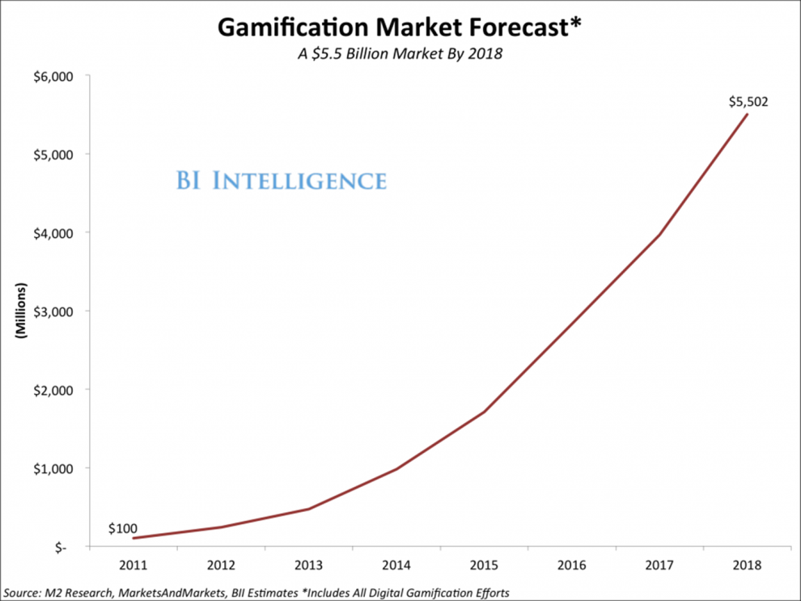
7. Sales Plan
Funding
Start-up: Corporate consortium (advisory committee from organizations)
Virtual program / organization
Viability
Growth industry and critical element of learning experience (e.g., pre-K to adult learning theories)
Portability between platforms, technologies, regions, and industries
Seek ISO 17024 accreditation
Gamficiation growth:
Implementation Schedule
Minimally viable product (MVP)
Initial product development in three months
Iterative revision cycles every 2-3 months
Adjust timeline as needed

Slide 9
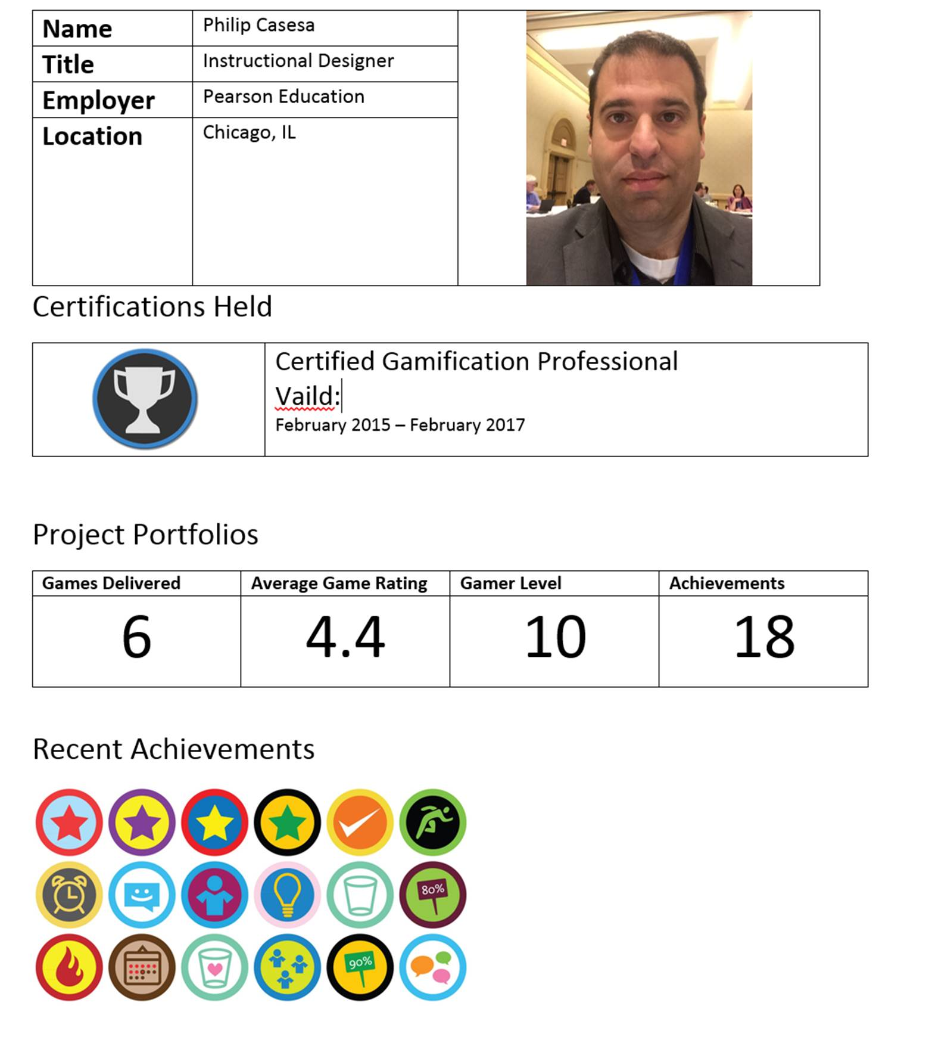
8. “Wild Card”

